Slide 1
Hadoop (Apache Hadoop)

Slide 2
What is Hadoop?
Hadoop is an open-source software framework that is used for storing and processing large amounts of data in a distributed computing environment.
It is designed to handle big data and is based on the MapReduce programming model, which allows for the parallel processing of large datasets.
Its framework is based on Java programming with some native code in C and shell scripts.

Slide 3
What is Hadoop?
Hadoop is commonly used in big data scenarios such as data warehousing, business intelligence, and machine learning. It’s also used for data processing, data analysis, and data mining. It enables the distributed processing of large data sets across clusters of computers using a simple programming model.

Slide 4
Two Main Components
HDFS and MapReduce
HDFS (Hadoop Distributed File System): This is the storage component of Hadoop, which allows for the storage of large amounts of data across multiple machines. It is designed to work with commodity hardware, which makes it cost-effective.
MapReduce: (Processing Unit of Hadoop) If a query is requested then MapReduce will process it according to key value pairs and find solution from multiple Data nodes

Slide 5
HDFS client
Name Node
Data node
Data node
Data node
Data node
Data node
Local Disk
Local Disk
Local Disk
Local Disk
Local Disk

Slide 6
Provides Rack Awareness: That a single data node should have different type of data in it like A,B,C
Copy of A on average 3 copies are saved on different Data nodes to sure Fault Tolerance.

Slide 7
Functions of NameNode
It records the Meta Data of all the files stored in the cluster e.g Location of blocks stored, size of the files, permissions, hierarchy.
Two files associated with meta data:
FSImage:it contains the complete state of the file system namespace since the start of the namenode.
EditLogs:it contains all the recent modifications made to the file system with respect to the most recent FSImage.
It regularly receives a heartbeat and a block reportfrom all the data nodes in the cluster to ensure that the data nodes are live.

Slide 8
MapReduce
MapReduce performs the processing of large data set in a distributed and parallel manner.
Two distinct tasks: Map and Reduce
Two essential components: Job Tracker and Task Tracker
Job Tracker: Resource Management, Scheduling, Monitioring

Slide 9
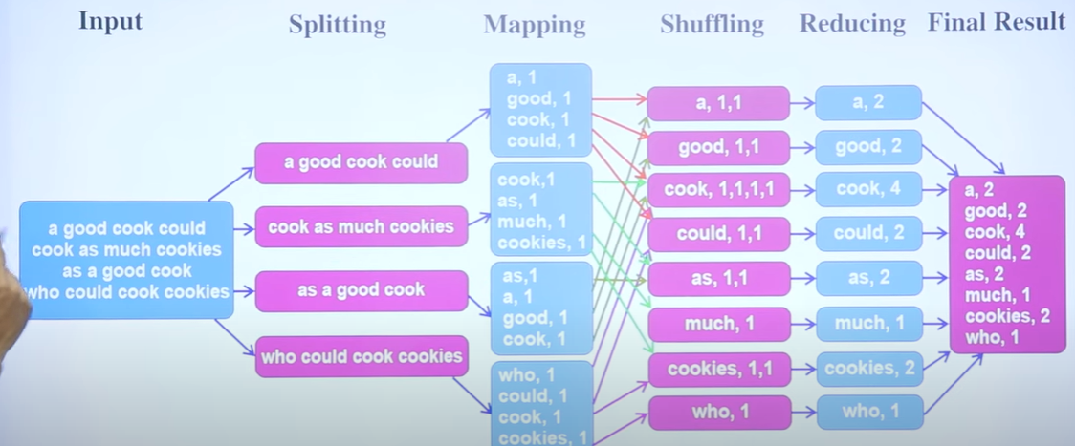
MapReduce working

Slide 10
Other Components
YARN (Yet Another Resource Negotiator): This is the resource management component of Hadoop, which manages the allocation of resources (such as CPU and memory) for processing the data stored in HDFS.
Hadoop also includes several additional modules that provide additional functionality, such as Hive (a SQL-like query language), Pig (a high-level platform for creating MapReduce programs), and HBase (a non-relational, distributed database).

Slide 11
Features of Hadoop
Distributed Storage: Hadoop stores large data sets across multiple machines, allowing for the storage and processing of extremely large amounts of data.
Scalability: Hadoop can scale from a single server to thousands of machines, making it easy to add more capacity as needed.
Fault-Tolerance: Hadoop is designed to be highly fault-tolerant, meaning it can continue to operate even in the presence of hardware failures.
Data locality: Hadoop provides data locality feature, where the data is stored on the same node where it will be processed, this feature helps to reduce the network traffic and improve the performance

Slide 12
Features of Hadoop
High Availability: Hadoop provides High Availability feature, which helps to make sure that the data is always available and is not lost.
Flexible Data Processing: Hadoop’s MapReduce programming model allows for the processing of data in a distributed fashion, making it easy to implement a wide variety of data processing tasks.
Data Integrity: Hadoop provides built-in checksum feature, which helps to ensure that the data stored is consistent and correct.
Data Replication: Hadoop provides data replication feature, which helps to replicate the data across the cluster for fault tolerance.

Slide 13
Features of Hadoop
Data Compression: Hadoop provides built-in data compression feature, which helps to reduce the storage space and improve the performance.
YARN: A resource management platform that allows multiple data processing engines like real-time streaming, batch processing, and interactive SQL, to run and process data stored in HDFS.

Slide 14
Some common frameworks of Hadoop
Hive- It uses HiveQl for data structuring and for writing complicated MapReduce in HDFS.
Drill- It consists of user-defined functions and is used for data exploration.
Storm- It allows real-time processing and streaming of data.
Spark- It contains a Machine Learning Library(MLlib) for providing enhanced machine learning and you can seamlessly integrate data processing tasks with machine learning tasks within the same framework. It also supports Java, Python, and Scala.
Pig- It has Pig Latin, a SQL-Like language and performs data transformation of unstructured data.
Tez- It reduces the complexities of Hive and Pig and helps in the running of their codes faster.

Slide 15
